Slide 1
Analyzing Admissions Trends with Data Science
Have the admissions profiles of our students changed over the years, and what factors predict success?

Slide 2


Data Science
Excel + Coding + Powerful Visualization Tools + Machine Learning
By 2020 the number of Data Science and Analytics job listings is projected to grow by 28%
Uses Python, which is the language our CS courses are taught in

Slide 3
Have the admissions profiles of our students changed over the years?
What factors of an admissions profile best predict academic success?
The Questions:

Slide 4
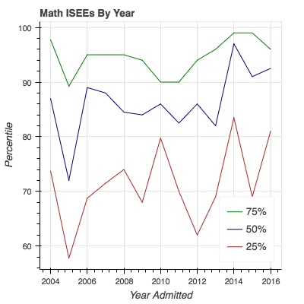
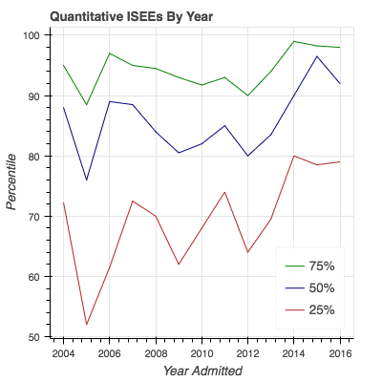
Math and Quantitative Entrance Exam Scores (‘04 - ‘17)
Notes:
Trending slightly up. Over the past five years, math scores are higher than ever.

Slide 5
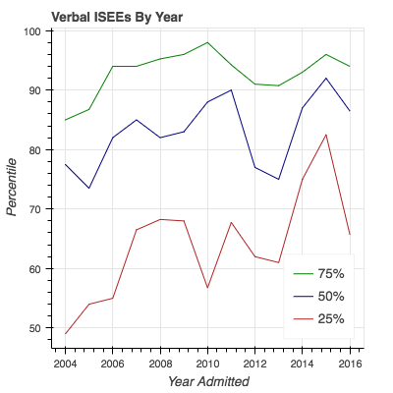
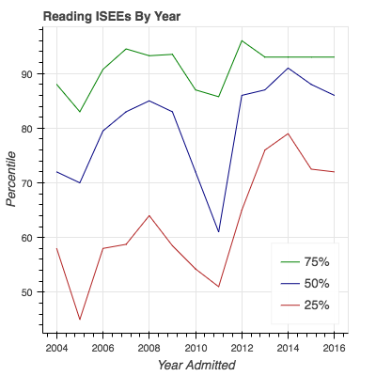
Verbal and Reading Entrance Exam Scores (‘04 - ‘17)
Notes:
Trending slightly up. The last five years have also seen a spike in verbal scores, especially at the lower end of the admitted class.

Slide 6
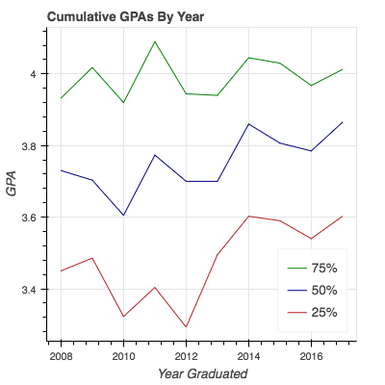
Admissions scores are trending up, but what about GPAs?
Graduating GPAs (‘08 - ‘17)
Notes:
GPAs are trending up as well. While we do not know if grade inflation plays a role in the upward trend in GPAs for the bottom 50% of each class, it is encouraging to see that the trend is reflected in admissions testing scores.

Slide 7
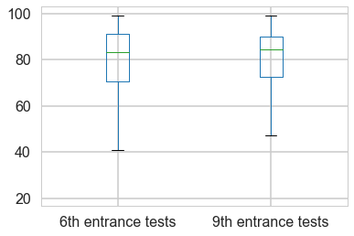
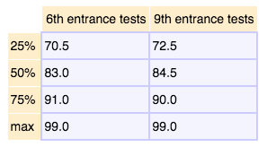
Is there a difference between the students we admit in 6th grade vs. 9th grade?
Entrance Exams (‘04 - ‘17)
Notes:
The boxplots on the right show the 2% and 98% of all entering 6th and 9th graders with tick marks, and then the 25%, 50%, and 75% by the edges of the box and the line in the middle. As you can see, their average test scores are nearly identical.

Slide 8
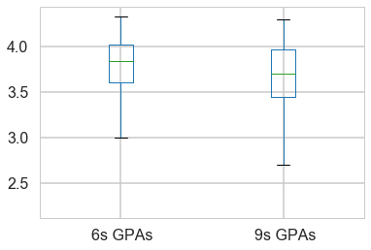
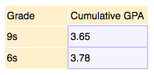
Does coming to Crystal in 6th vs 9th effect cumulative GPA though?
Graduating GPAs (‘08 - ‘17)
Notes:
Yes, massively! As you can see, students who come in 6th grade leave Crystal with a higher GPA than those who enter in 9th grade. Kudos to the middle school!

Slide 9
Do Entrance Exams Matter?
Do entrance exam scores correlate with graduating GPA?
Does another aspect of a student’s admissions profile better predict success?
Notes:
Before we move on, I would like you to take a moment and talk to the person next to you about whether you think that a student with strong or weak entrance exam scores

Slide 10
What aspects of a student’s admissions profile predict success?
Built a machine learning model that takes admissions profiles and uses them to predict cumulative GPAs.
Variables used:
Grade admitted, gender, previous school, year entered, ethnicity, hometown, how they heard about the school, grades, essays, recommendation letter ratings, and standardized test scores.
r² = 0.565 (6th) and 0.531 (9th)
Means somewhat predictive
r² = 1 would be perfect, r² = 0 would have no predictive power
Notes:
The model says that admissions profiles are somewhat predictive of a student’s graduating GPA, and the factors that best predict GPA are...

Slide 11
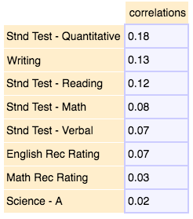
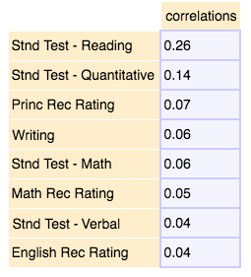
Can the model predict more successfully with 6th or 9th graders?
6th graders, r² = 0.565 9th graders, r² = 0.531
45% of predictive power from std. tests
50% of predictive power from std. tests
Notes:
It appears that predicting from 6th grade admissions profiles is slightly more accurate than 9th grade. Also, standardized tests are the best predictors of GPA success, but certain subjects are much more important than others...

Slide 12
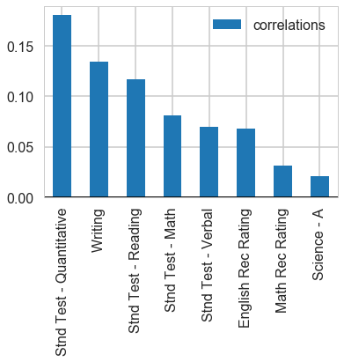
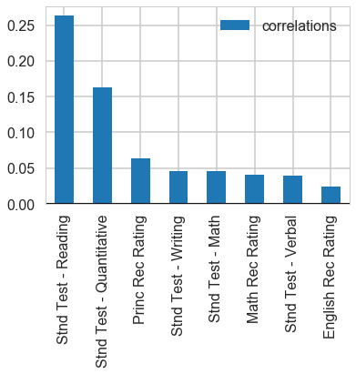
Can the model predict more successfully with 6th or 9th graders?
6th graders, r² = 0.565 9th graders, r² = 0.531
Notes:
For 6th graders, the most important factors are quantitative standardized test scores (twice as important as Math or Verbal), as well as writing and reading scores.
For 9th graders, a student’s Reading standardized test score is twice as predictive as their Quantitative score, and at least ~5x more predictive than any other factor.

Slide 13
Takeaways
The students who go to our middle school graduate with higher GPAs
Standardized entrance test scores are the best quantitative metric we have for predicting graduation GPA
For 6th graders, quantitative, and reading scores are most important, along with essays
For 9th graders, reading score is by far the most important metric, followed by quantitative score
Many factors not included:
Interview scores, sports, arts, multilingual, extracurriculars, etc.

Slide 14
Further Questions
Do standardized test scores predict subject area scores?
How much movement between GPA quartiles is there? Do students who test well or poorly tend to graduate at the top or bottom of the class?
Do grades in certain classes or subjects predict PSAT or SAT scores better than others?

Slide 15
Thank you!
Special thanks to the administrative team who suggested the project
Kelly, Linda and Admissions, Jeannie, Jean, and Ken who were essential in collecting the data

